Slide 1


Sibling Dynamics on Social Media: Analyses of A Selected Sibling Sample Based on Archived Twitter Data
Xiaoran Sun, Guangqing Chi, Junjun Yin, & Susan M. McHale
The Pennsylvania State University
2018-10-5 SRCD DEVSEC

Slide 2
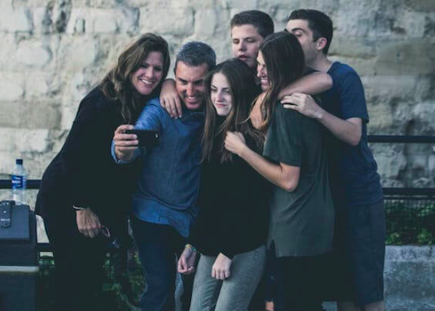
Background
Siblings play important roles in one another’s development (McHale et al., 2012).
Research on sibling dynamics has used global questionnaires with a focus on siblings’ relationship characteristics and day-to-day exchanges.
https://www.tun.com/blog/wp-content/uploads/2018/06/campus-family-visit.jpg
Notes:
Siblings play important roles in one another’s development (McHale et al., 2012). Research on sibling dynamics has used global questionnaires and focused on their relationship characteristics and day-to-day exchanges.
We know much less about sibling dynamics in an online context, despite of the expansion of social media that may provide unique opportunities for siblings’ connectedness (Dworkin, Rudi, & Hessel, 2018 ).
Open source data from Twitter allow us to examine sibling interaction patterns on a social media platform. A model comes from research showing that Twitter data can capture connectedness in romantic relationships (Garimella et al., 2014).

Slide 3
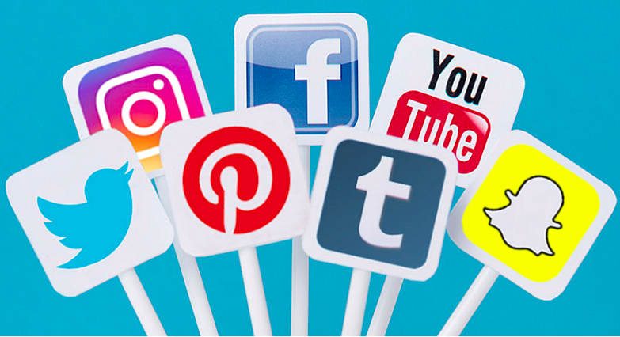
However…
?
https://www.adlibbing.org/2018/02/12/4-lessons-from-top-social-media-publishers/
We know much less about sibling dynamics in an online context, despite the fact that social media plays an important role in many people’s daily life and may provide unique opportunities for siblings’ connectedness (Dworkin, Rudi, & Hessel, 2018 ).
Notes:
People express their opinions, show their interests and attitudes on social media; they also use social media to get connected with others, including family members.
Research has shown that among young adults, social media has become an important communication tool with siblings; they are more comfortable about connecting to siblings than parents online.
Open source data from Twitter allow us to examine sibling interaction patterns on a social media platform. A model comes from research showing that Twitter data can capture connectedness in romantic relationships (Garimella et al., 2014).

Slide 4
https://www.adlibbing.org/2018/02/12/4-lessons-from-top-social-media-publishers/
Open source data from Twitter allow us to examine communications about siblings on a social media platform with unobtrusive, non-reactive, objective observations.
A relevant model comes from research showing that Twitter data can capture connectedness in romantic relationships (Garimella et al., 2014).
Notes:
Open source data from Twitter allow us to examine sibling interaction patterns on a social media platform. A model comes from research showing that Twitter data can capture connectedness in romantic relationships (Garimella et al., 2014).

Slide 5
Aims
Identify sibling users on Twitter
Analyze communications with and about siblings on Twitter
Twitter as a social networking site (Zhao & Rosson, 2009)
Analyze sibling similarities based on their Twitter data
Shared interests (i.e., following accounts): Twitter as an information gathering channel, such as via following accounts and trending topics (Zhao & Rosson, 2009)
Emotion expressions (i.e., sentiment in tweets): user language on Twitter has been linked to psychological characteristics, such as personality and mental health status (Settanni et al., 2018).

Slide 6
Sample: Identifying Sibling Users
All geo-tagged tweets in the U.S. posted from 12-16-2015 through 12-31-2015 (Archived by Chi, Van Hook, & Yin, 2017).
Approximately 4.8 million tweets in total (13.4 GB)
Notes:
Winter holiday

Slide 7
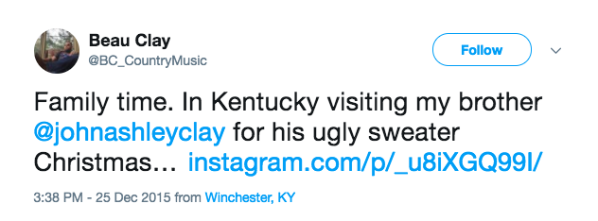
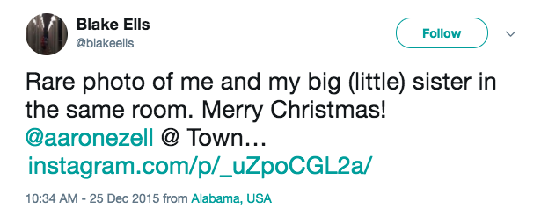
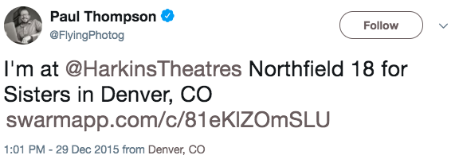
Sample: Identifying Sibling Users
All geo-tagged tweets in the U.S. posted from 12-16-2015 through 12-31-2015 (Archived by Chi, Van Hook, & Yin, 2017).
Approximately 4.8 million tweets in total (13.4 GB)
Grepped tweets that contained one of the following keywords, “sister(s)” “brother(s)” “sis” “bro(s)” “sissy” “sibling(s),” and in which the user (User 1) mentioned another user (User 2).
4,722 tweets grepped.
User1 name
@user1name
User1 name
@user1name
user2name
user2name
User1 name
@user1name

Slide 8
Sample: Identifying Sibling Users
Independent coders classified the tweeters’ (User1 and User 2) relationship as sibling versus other based on the tweet content, with a 92% agreement rate.
Discussions among all coders resolved inconsistencies. Each sibling user’s biological sex was also tagged in this process.
477 sibling dyads identified

Slide 9
Sample: Identifying Sibling Users
Independent coders classified the tweeters’ (User1 and User 2) relationship as sibling versus other based on the tweet content, with a 92% agreement rate.
Discussions among all coders resolved inconsistencies. Each sibling user’s biological sex was also tagged in this process.
477 sibling dyads identified
We eliminated dyads in which at least one sibling’s Twitter account was protected, suspended, deleted, or inactive (i.e., 0 following accounts) at the time of preliminary analyses (01-2018).
We stored all the sibling users’ userid and username
279 sibling dyads remained for analyses
54 brother-brother
122 sister-sister
103 mixed-sex dyads

Slide 10


Measures
Frequency of tweets to and about siblings
Using Twitter’s API (Application Programming Interface), we extracted all available tweets of the sibling users over a year from 12-25-2015 to 12-25-2016.
(Using Get-Old-Tweets Python project, by Jefferson Henrique https://github.com/Jefferson-Henrique/GetOldTweets-python)
Among those tweets, we extracted each user’s tweets that mentioned their target sibling’s username
Frequency: # of tweets mentioning the sibling
Proportion: (# of tweets mentioning the sibling)/(total # of tweets over the year)
Notes:
Don’t say

Slide 11
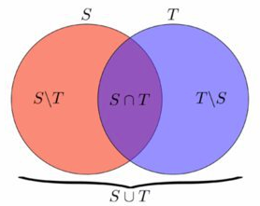
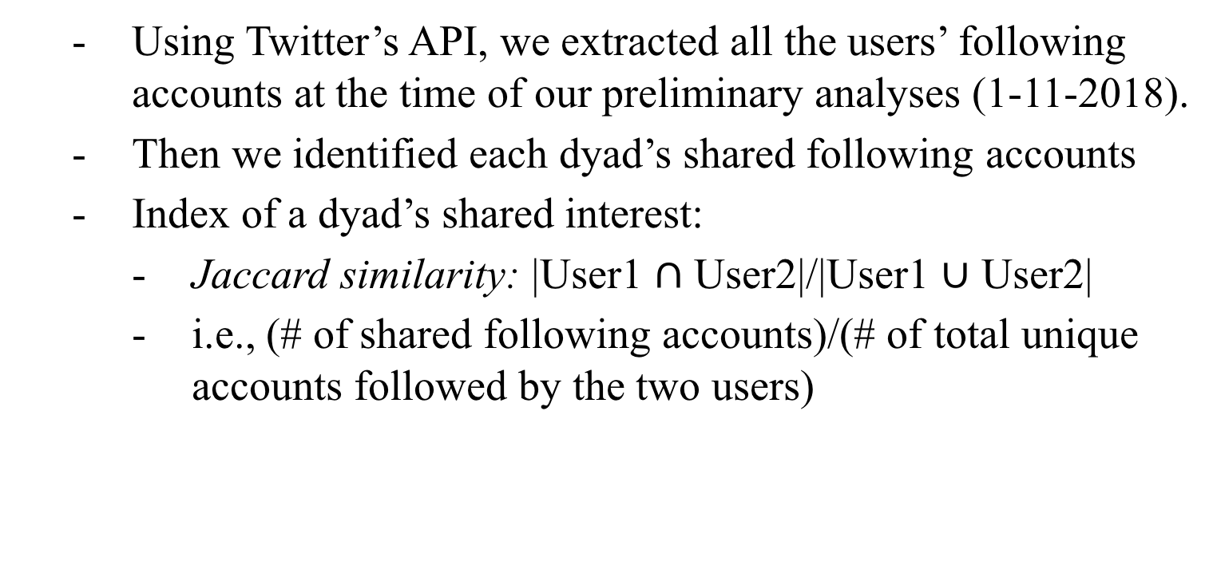
Measures
Dyad similarities– Shared interests
Using Twitter’s API, we extracted all the users’ following accounts at the time of our preliminary analyses (1-11-2018).
Then we identified each dyad’s shared following accounts
Index of a dyad’s shared interest:
Jaccard similarity: |User1 $∩$ User2|/|User1 $∪$ User2|
i.e., (# of shared following accounts)/(# of total unique accounts followed by the two users)

Slide 12

Measures
Dyad similarities– Emotion expressions
We conducted sentiment analysis on each user’s every tweet.
Using the nltk package in Python 3, the SentimentAnalyzer tool
Then we calculated the mean scores of each user in:
Positive sentiment (0, 1)
Negative sentiment (0, 1)
Neutral sentiment (0, 1)
Compound sentiment (-1, 1)
Index of a dyad’s difference in sentiment:
Absolute difference scores on each sentiment index

Slide 13
Analyses
Variation among siblings dyads
Does frequency of sibling mentions on Twitter differ by dyad sex constellation?
Does sibling similarity on Twitter, including in interests and emotion expression, differ by dyad sex constellation?
Is frequency of tweets that mention the sibling associated with sibling similarity?
Differences between siblings vs. non-siblings
Are siblings more similar than two randomly paired individuals?

Slide 14
Question 1: Does the frequency of tweets to/about the sibling differ by dyad sex constellation?
Previous research: Global questionnaire data show that sister-sister dyads are closer than other sibling dyads (Kim et al., 2006).

Slide 15
Question 1: Does the frequency of tweets to/about the sibling differ by dyad sex constellation?
Indices of frequency of mentioning sibling
Frequency: # of tweets mentioning the sibling
Proportion: (# of tweets mentioning the sibling)/(total # of tweets over the year)
Measure | Min. | 1st Qu. | Median | Mean | 3rd Qu. | Max.
Total tweets | 1 | 78 | 267 | 900.50 | 781 | 22470
Sib mention- Frequency | 0 | 0 | 1 | 16.17 | 5 | 2543
Sib mention-proportion | .000 | .000 | .003 | .023 | .015 | 1.000

Slide 16
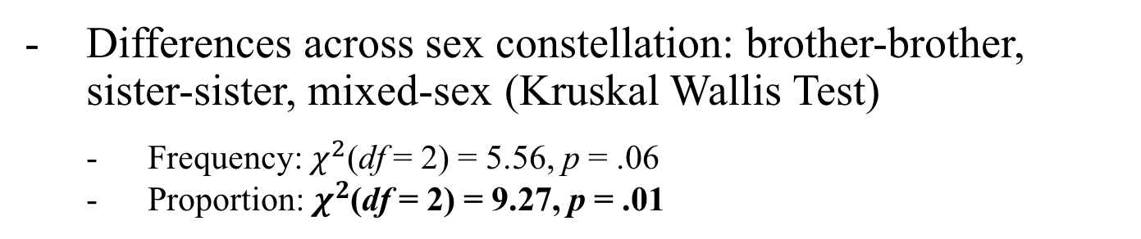
Question 1: Does the frequency of tweets to/about the sibling differ by dyad sex constellation?
Differences across sex constellation: brother-brother, sister-sister, mixed-sex (Kruskal Wallis Test)
Frequency: $χ^{2}$(df = 2) = 5.56, p = .06
Proportion: $χ^{2}$(df = 2) = 9.27, p = .01
Comparison | Z | p | Adjusted p
BB - SS | -.45 | .650 | .650
BB - Mixed | 1.92 | .054 | .081
SS - Mixed | 2.96 | .003 | .009
Sibling mention proportion scores on Twitter were consistent with previous findings that sister-sister dyads are closer than other dyads.
Notes:
A non-parametric method for testing whether sample originate from the same distribution
Dunn test for follow-up pairwise comparison (Zar, 2010)
Sibling interaction proportion scores on Twitter were consistent with previous findings that sister-sister dyads are closer to one another compared to other dyads.

Slide 17
Question 2: Does sibling similarity on Twitter differ by dyad sex constellation?
Background:
Gender stereotyped interests and emotional expression may lead to more similarities in same-sex vs. mixed-sex dyads (Maccoby, 1998; Plant et al., 2000).
Social learning theories hold that structural similarity (e.g., sex) promotes imitation (Bandura, 1977). Thus, same-sex siblings may be more similar than mixed-sex siblings

Slide 18
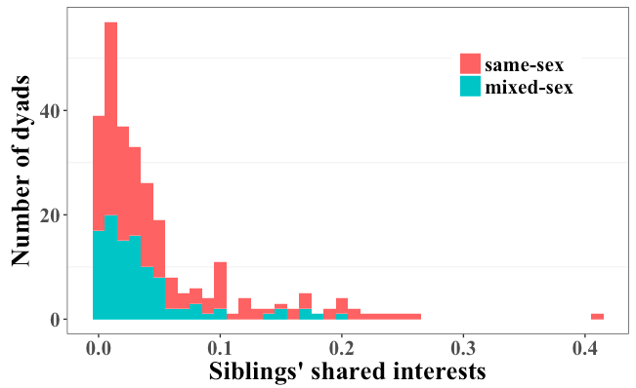
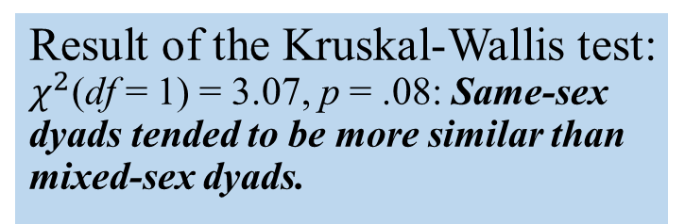
Question 2: Does sibling similarity on Twitter differ by dyad sex constellation?
Siblings’ shared interest:
Result of the Kruskal-Wallis test:
$χ^{2}$(df = 1) = 3.07, p = .08: Same-sex dyads tended to be more similar than mixed-sex dyads.

Slide 19
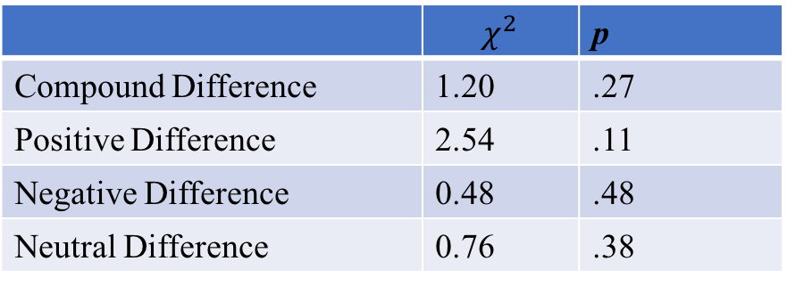
Question 2: Does sibling similarity on Twitter differ by dyad sex constellation?
Sibling differences in emotion expression:
 | $$χ^{2}$$ | p
Compound Difference | 1.20 | .27
Positive Difference | 2.54 | .11
Negative Difference | 0.48 | .48
Neutral Difference | 0.76 | .38
Same- and mixed-sex dyads do not differ in emotion expression on Twitter.
Notes:
bonferroni correction for multiple testing

Slide 20
Question 3: Is frequency of sibling-mentioned tweets associated with sibling similarity?
Notes:
Interactions promote similarity

Slide 21
Question 3: Is frequency of sibling-mentioned tweets associated with sibling similarity?
We tested a social learning (Bandura, 1978) hypothesis that the frequency of sibling mentions would be positively related to their similarities in interests and emotion expression.
Notes:
Interactions promote similarity

Slide 22
Question 3: Is frequency of sibling-mentioned tweets associated with sibling similarity?
Results:
Frequency and shared interests: tau = .22, p <.0001
Frequency and differences in emotion expression:
 | Frequency
Compound Difference | -.11 (p = .025)
Positive Difference | -.10 (p = .030)
Negative Difference | -.14 (p = .003)
Neutral Difference | -.11 (p = .023)
Consistent with social learning tenets, siblings who more often mentioned one another were more similar in their interests and emotion expression on Twitter.

Slide 23
Question 4: Are siblings more similar than two randomly paired individuals?
Due to their nonshared environments, siblings are often no more similar than unrelated individuals (Plomin, Ashbury, & Dunn, 2001; Plomin & Daniels, 1987)

Slide 24
Question 4: Are siblings more similar than two randomly paired individuals?
Based on the selected sibling sample, create non-sibling comparison sample:
Shuffle the match between User 1 and User 2 (i.e., shuffle the order of user 2)
make sure that 1) non-siblings are matched; 2) sex constellation remains the same
Compute shared interests & differences in emotion expression in non-sibling dyads;
Compare sibling vs. non-sibling dyads

Slide 25
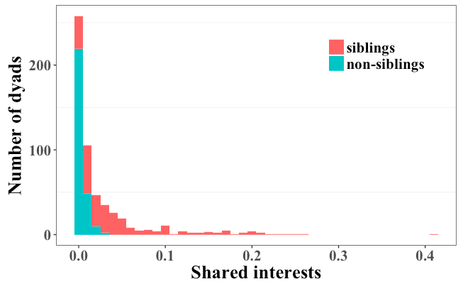
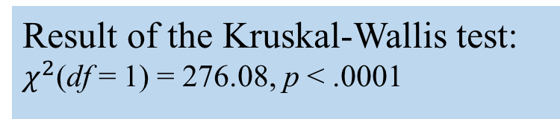
Question 4: Are siblings more similar than two randomly paired individuals?
Result of the Kruskal-Wallis test:
$χ^{2}$(df = 1) = 276.08, p < .0001
Siblings are more similar in interests on Twitter than are non-siblings.

Slide 26
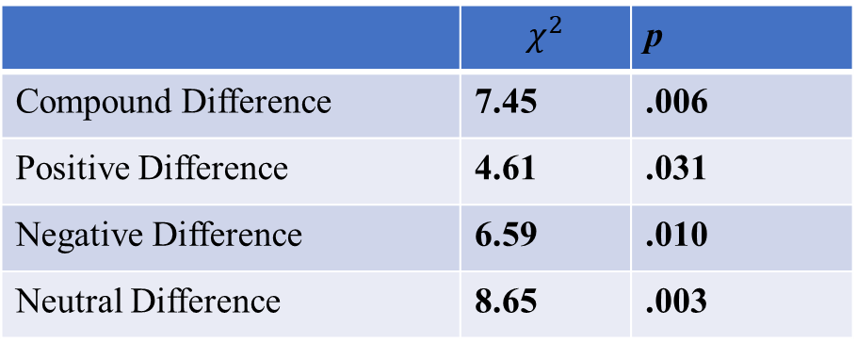
Question 4: Are siblings more similar than two randomly paired individuals?
Differences in emotion expression: siblings vs. non-siblings
 | $$χ^{2}$$ | p
Compound Difference | 7.45 | .006
Positive Difference | 4.61 | .031
Negative Difference | 6.59 | .010
Neutral Difference | 8.65 | .003

Slide 27
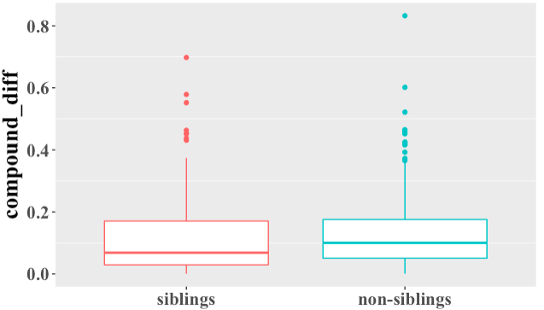
Question 4: Are siblings more similar than two randomly paired individuals?
Differences in emotion expression:
siblings vs. non-siblings
Siblings are more similar in emotion expression on Twitter than are randomly paired individuals.

Slide 28
Limitations
Selected, biased sample
Links to relationship characteristics unknown

Slide 29
Limitations
Selected, biased sample
Links to relationship characteristics unknown
Future directions
Obtain demographic information (e.g., age, SES, race/ethnicity, location) using data on Twitter (e.g., image, text, geographical location)
Link Twitter to survey/interview/observation data
Upscale sample size: Train algorithms to automatically identify sibling dyads

Slide 30

Acknowledgement
This material is based on work supported by the National Science Foundation under IGERT Grant DGE-1144860, Big Data Social Science.
We thank Jiaxun Lyu, Ru Jia, and Yuqin Liu for their assistance with manual classification, and Tingyu Mao and Bingyuan Liu for their support on the analyses.

Slide 31
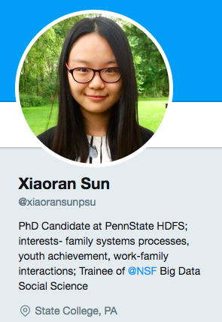
Thanks for attention! Questions & Thoughts?
Xiaoran.sun@psu.edu
Notes:
V c

Slide 32
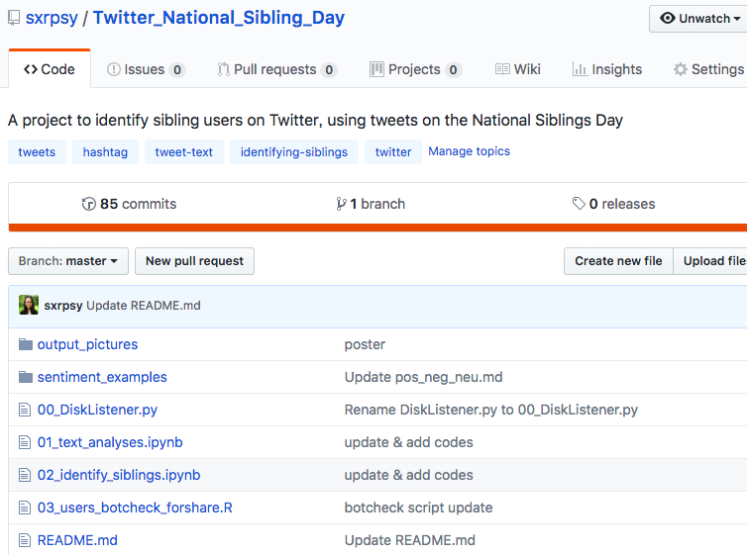

Slide 33
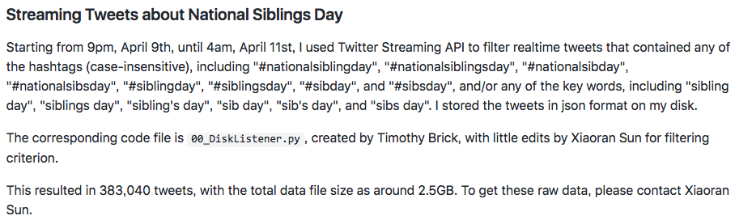

Slide 34
Text analysis (hashtag, ngrams, topic modeling, sentiment analysis), botcheck
383,040 tweets
22,407 tweets
~70% true positive

Slide 35
